Slide 1
New GA Orientation August 21, 2019
Marnie Saunders, PhD
Associate Dean, The Graduate School
Associate Professor, Department of Biomedical Engineering

Slide 2
Welcome
and
Thank You
for choosing The University of Akron for your graduate work

Slide 3
Welcome from Dean Midha
Chand Midha, PhD
Interim Executive VP and Chief Academic Officer
Executive Dean of the Graduate School

Slide 4
SCHEDULE:
9:00-9:10 - Graduate School Welcoming Remarks, Dean Chand Midha
9:10-10:00 - Graduate School Introduction, Marnie Saunders
10:00-10:20 - Health Services, Megan Nichols
10:20-11:00 - Code of Conduct and Title IX, Dean of Students, Michael Strong
11:00-11:30 - Lunch
11:30-12:00 - Payroll, Diane Shovestull
12:00-12:30 – Financial Aid, Deniesha Newby
12:30-12:45 - Break
12:45-1:15 - Graduate Student Government, President and Vice President
1:15 – 2:00 - myIDP/ImaginePhD, Marnie Saunders

Slide 5
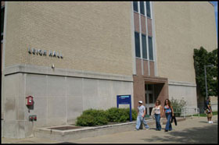
Where are we?
The Graduate School Leigh Hall, Room 515 Akron OH 44325-2101
Phone: 330-972-7663 Fax: 330-972-6475
gradsch@uakron.edu

Slide 6
Who are we?
Staff:
Ms Heather Blake – Curriculum support
Ms Karen Caldwell – GA Contracts
Dr Karen Greene – Admission, Graduation
Ms Tanya Kauffman – General Support

Slide 7
About The University of Akron
Source: Program Review Enrollment Dashboard Fall 2018
Enrollment
20,554 Total
14,826 Full time
5,728 Part time
Graduate Enrollment
2,625 Total
1,488 Full time
1,137 Part time

Slide 8
About The University of Akron
Faculty
395 Full Time Graduate Faculty
Programs
20 PhD, 73 MS and 4 JD offerings in 6 colleges and the Law School

Slide 9
About The University of Akron
Graduate Opportunities in Colleges:
College of Arts & Sciences
College of Business
College of Education
College of Engineering
College of Health Professions
College of Polymer Science and Polymer Engineering
Law School

Slide 10
Graduate Student Government
Mission
The Graduate Student Government of The University of Akron, hereby set forth to structure an effective representative graduate student government in the interests of all substantive matters pertaining to the general welfare of The University of Akron graduate students, with the intention of providing advocacy in the formulation and application of University and community policies, and with the ambition of enhancing the quality of life for all graduate students, hereby institute Graduate Student Government at The University of Akron
Graduate Student Government Student Union - Room 307C 330-972-7002 Akron, OH 44325-4601
E-mail: gsgpresident@uakron.edu
Advisors– Dr Ann Usher and Dr Paul Levy

Slide 11
Graduate Student Government

Slide 12
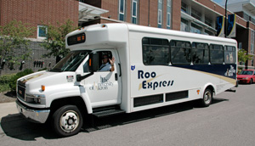
How to get around?
https://www.uakron.edu/parking/
The Roo Express Shuttle Service provides transportation to University buildings in the downtown area, neighborhoods near campus, and the parking lots on the North side of campus. During the fall and spring semesters the shuttle also services students on the weekends to and from the downtown area

Slide 13
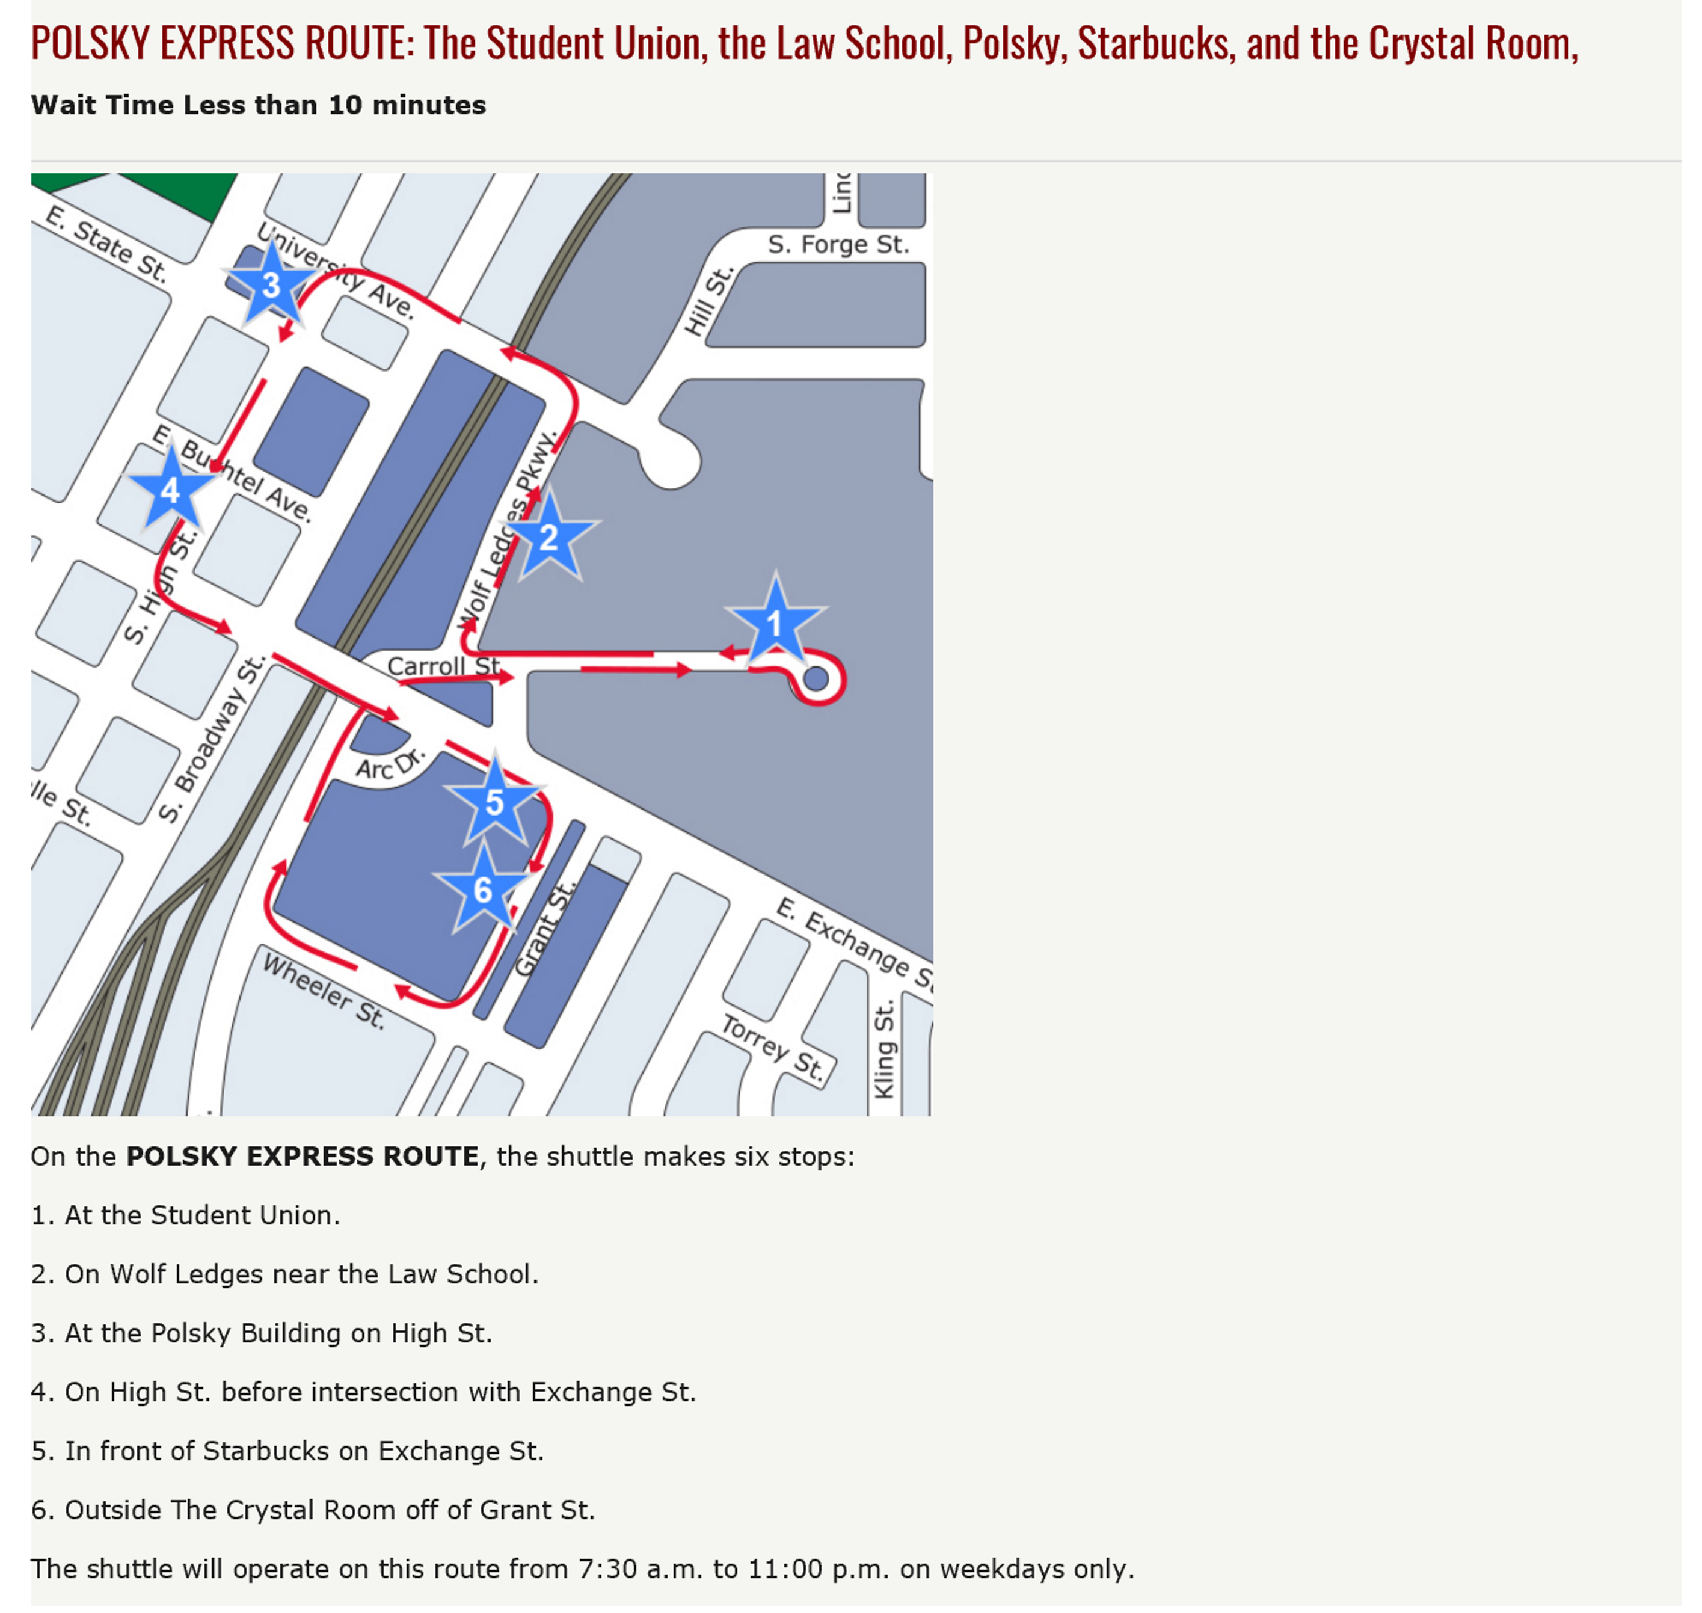
How to get around?
https://www.uakron.edu/parking/

Slide 14
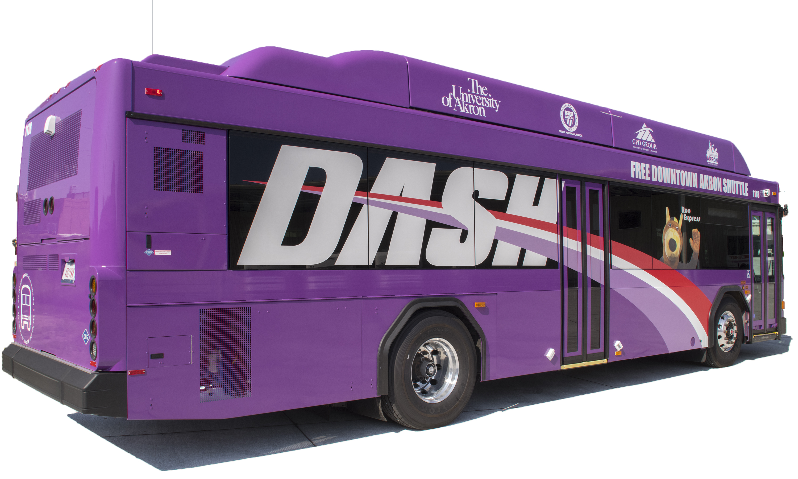
How to get around?
https://www.uakron.edu/parking/
The DASH runs approximately every 10 minutes from 7 a.m. to 7 p.m. and every 15 minutes from 7 p.m. to 11 p.m.
The University of Akron and Akron METRO RTA have collaborated to create the free Downtown Akron Shuttle (DASH), connecting various University and downtown locations. You will recognize the METRO DASH buses by their bright purple color and a picture of Zippy waving from the passenger side. This fleet of new buses feature: Free Wifi / Additional seating / Realtime bus tracking

Slide 15
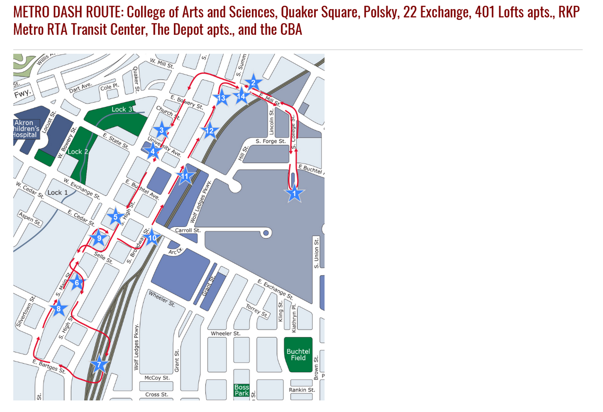
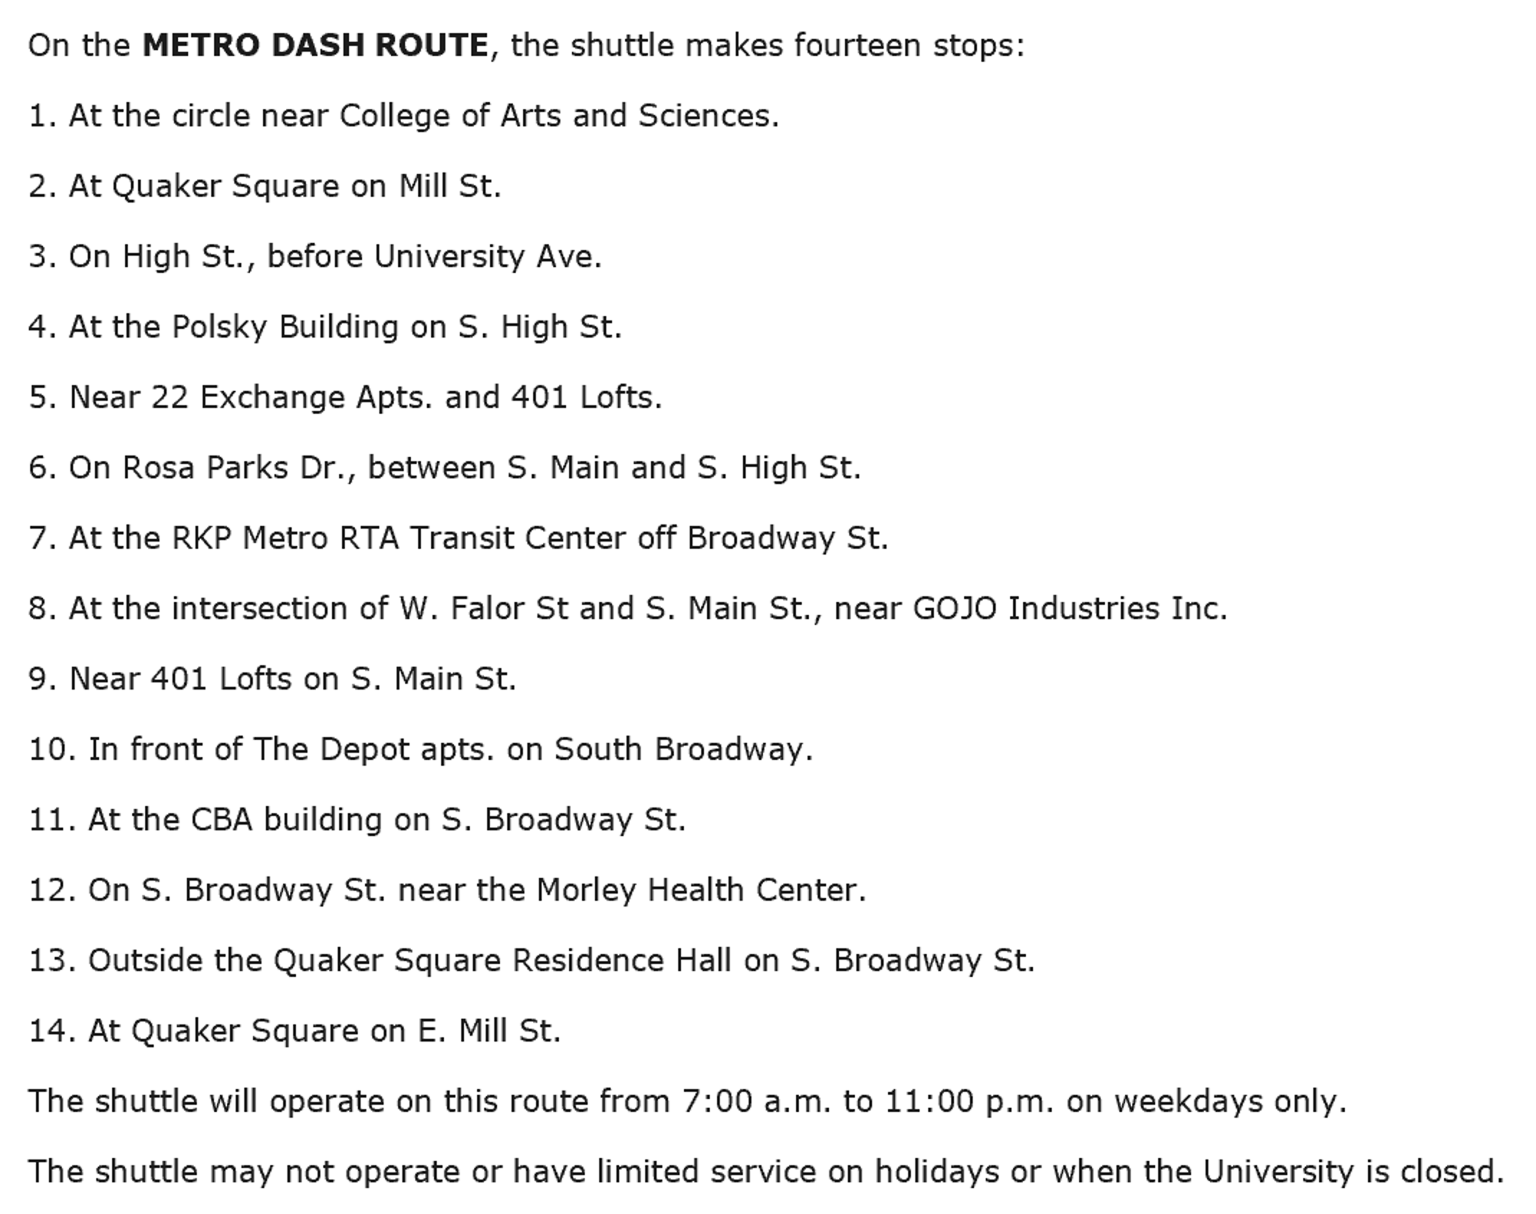
How to get around?
https://www.uakron.edu/parking/

Slide 16
How to get around?
https://www.uakron.edu/parking/
Cycling Initiative
Bike Share – Through Student Recreation and Wellness Center

Slide 17
Recreational Activities
https://uakron.edu/rec/

Slide 18
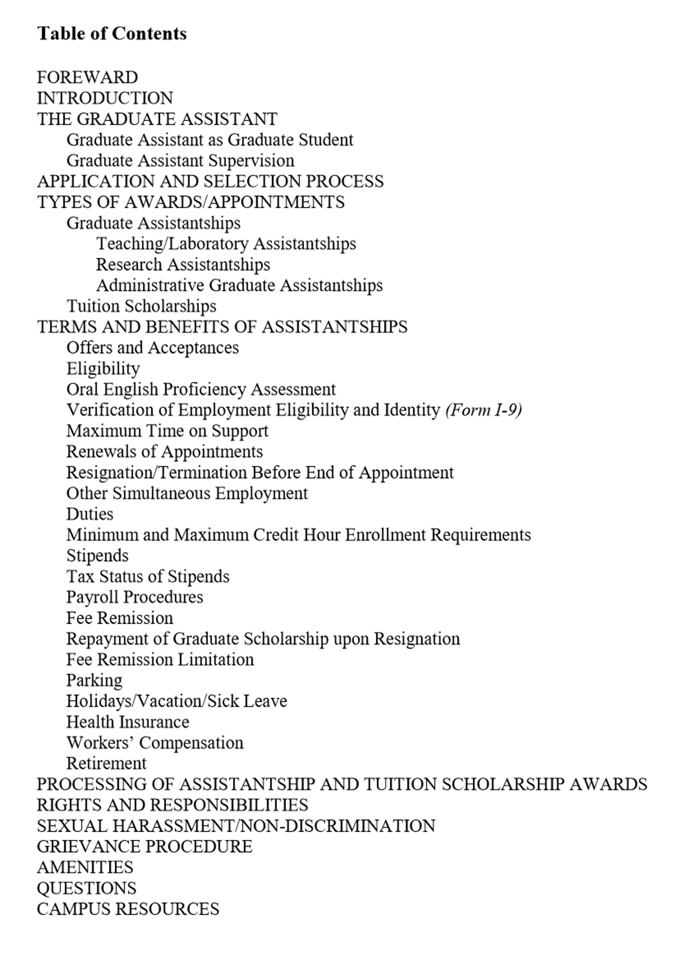
Why you’re here - ACADEMICS
https://www.uakron.edu/dotAsset/678001.pdf
The Graduate Assistant Handbook
Your primary reference guide

Slide 19
ACADEMICS- Eligibility
Eligibility for a Graduate Assistantship
Full Admission to a Graduate Program
You must be enrolled as a full-time student during each semester you are working as a graduate assistant.
Full-time definition
Fall and Spring – minimum of 9 hours
Summer – minimum of 6 hours
Maintain a minimum cumulative 3.0 GPA and progressing toward degree completion
Maximum work hours may not exceed 20 hours/per week
Students may not hold additional employment if on a full-time assistantship

Slide 20
ACADEMICS- Eligibility
Maintaining a Graduate Assistantship
You are required to perform your graduate assistantship duties satisfactorily
You must maintain the standards of academic conduct
You must honor the terms of your contract agreement
If a TA – you must meet the minimum oral proficiency requirement
23 – TOEFL Speaking Component (Internationals)
Assessed by departmental procedures (domestics)
If you give up your assistantship – you also give up the tuition waiver – repayment is required (after Census date)

Slide 21
ACADEMICS- Eligibility
FEE REMISSION FOR GRADUATE ASSISTANTS (GAs)
UA shall provide a scholarship during each semester or summer session of award
Scholarships are not provided for:
undergraduate/audit courses professional fees
administrative fees facilities fees
technology fees drop/add fees
library fees miscellaneous fees
general service fees late registration fees
tuition/fees at other institutions

Slide 22
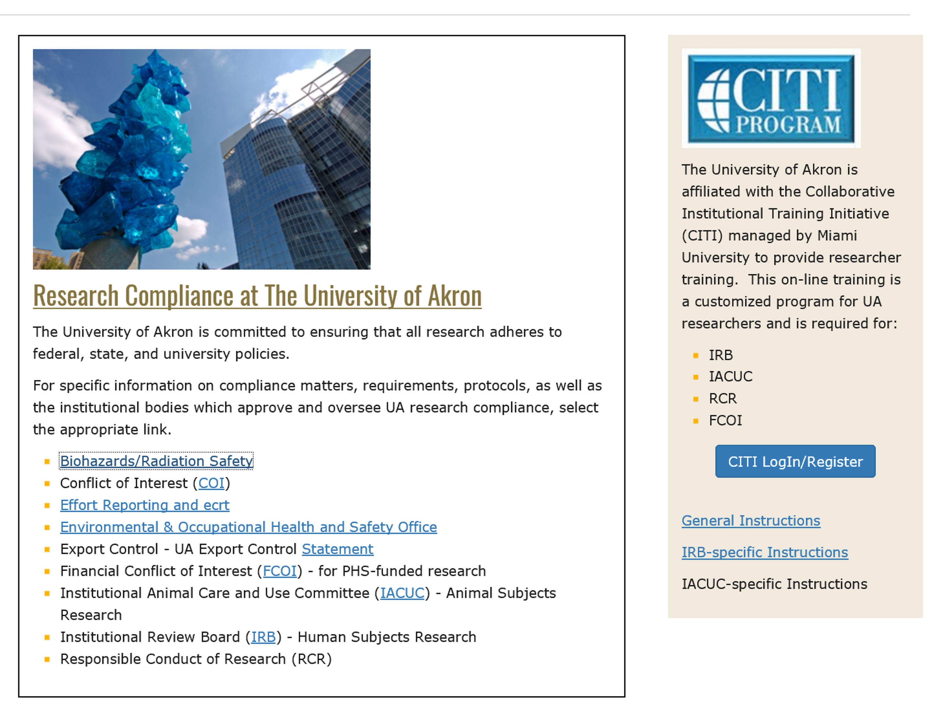
ACADEMICS- Eligibility
OFFICE OF RESEARCH ADMINISTRATION
https://www.uakron.edu/research/ora/

Slide 23
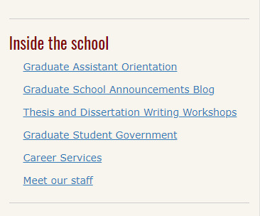
Grad School Blog

Slide 24
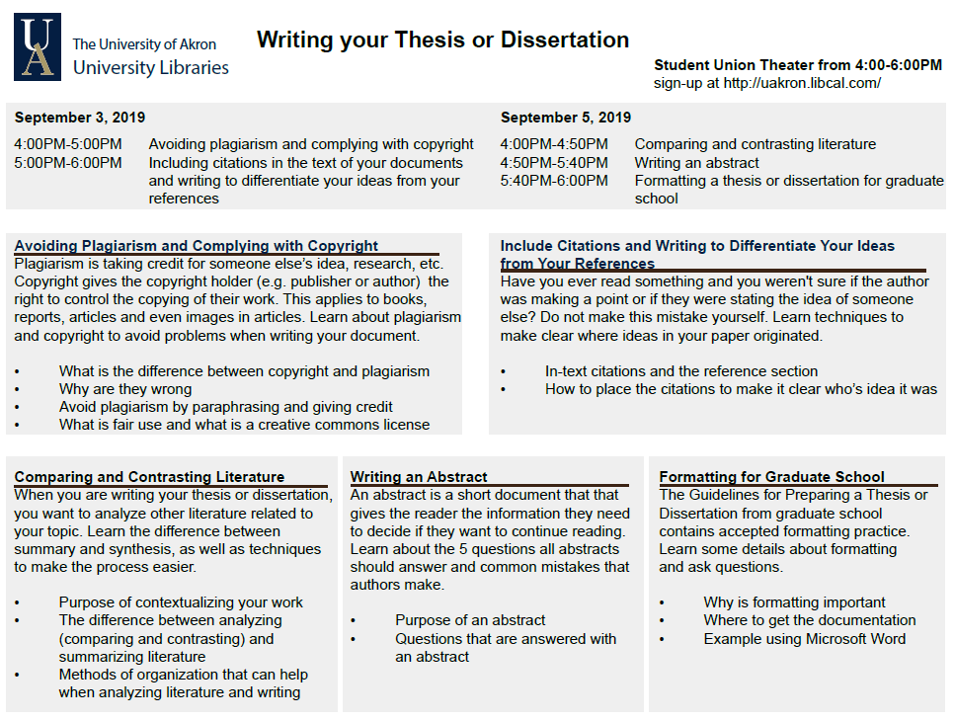
Fall Semester Events

Slide 25
Spring Semester Events
Graduate Student Appreciation Week
April 6-10th
Professional development and fun activities
More to follow…..

Slide 26
Semester Events

Slide 27
Semester Events

Slide 28
Links for Individual Development Plan
myIDP – STEM Fields
https://myidp.sciencecareers.org/
ImaginePhD – Social Science Fields
https://www.imaginephd.com/

Slide 29
Questions

Slide 30
SCHEDULE:
9:00-9:10 - Graduate School Welcoming Remarks, Dean Chand Midha
9:10-10:00 - Graduate School Introduction, Marnie Saunders
10:00-10:20 - Health Services, Megan Nichols
10:20-11:00 - Code of Conduct and Title IX, Dean of Students, Michael Strong
11:00-11:30 - Lunch
11:30-12:00 - Payroll, Diane Shovestull
12:00-12:30 – Financial Aid, Deniesha Newby
12:30-12:45 - Break
12:45-1:15 - Graduate Student Government, President and Vice President
1:15 – 2:00 - myIDP/ImaginePhD, Marnie Saunders

